Slide 1
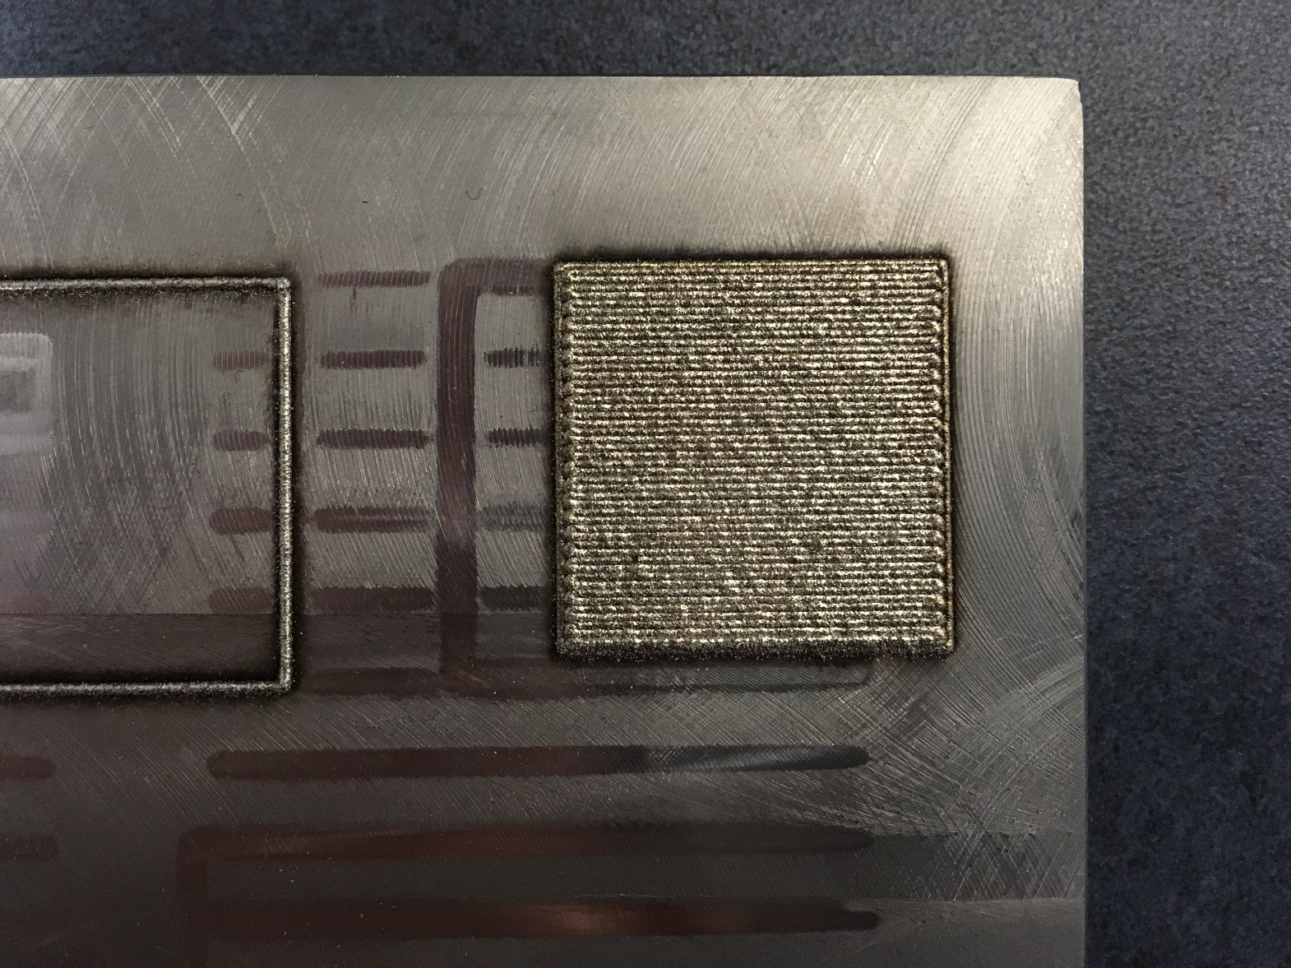
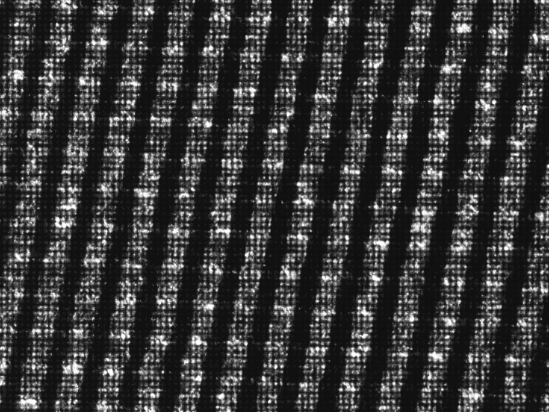
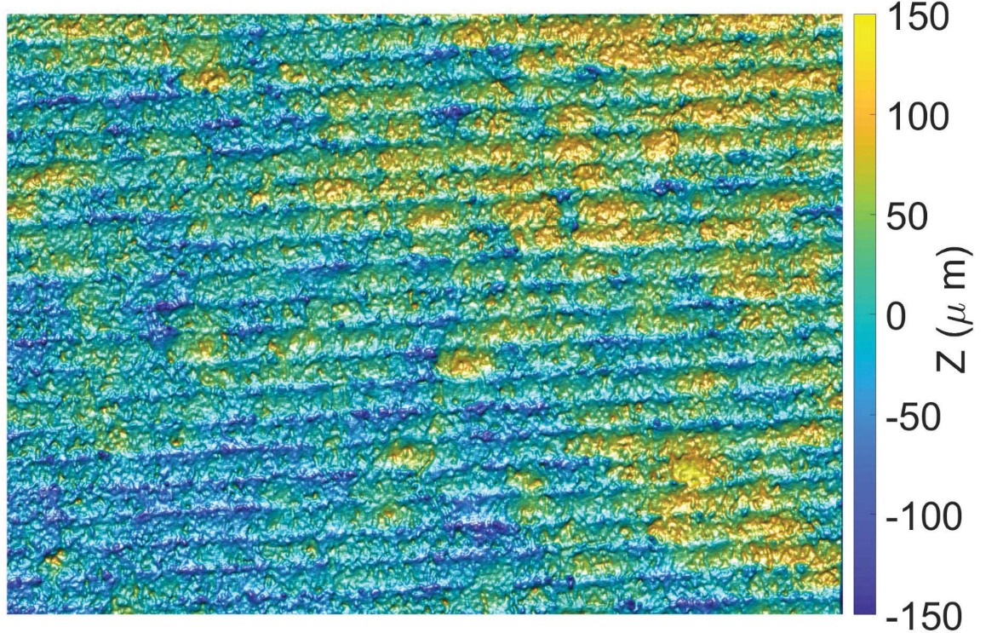
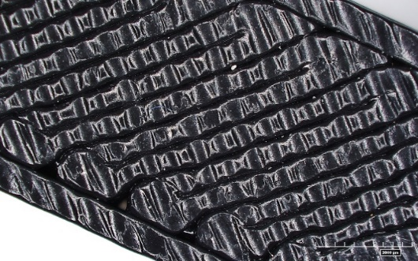
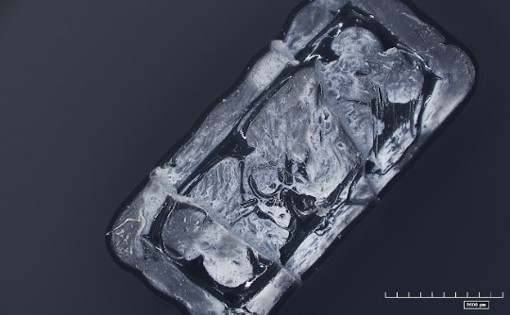
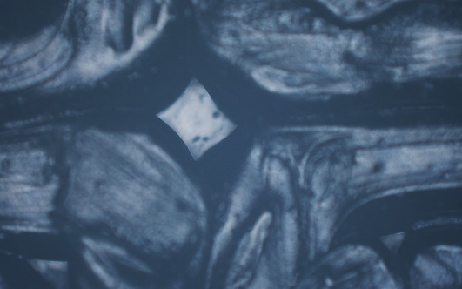
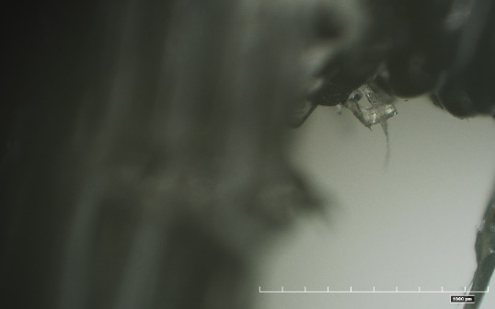
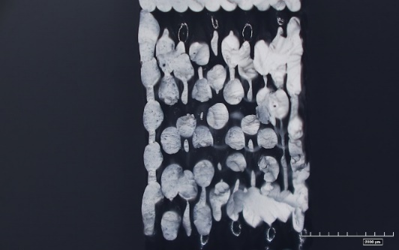
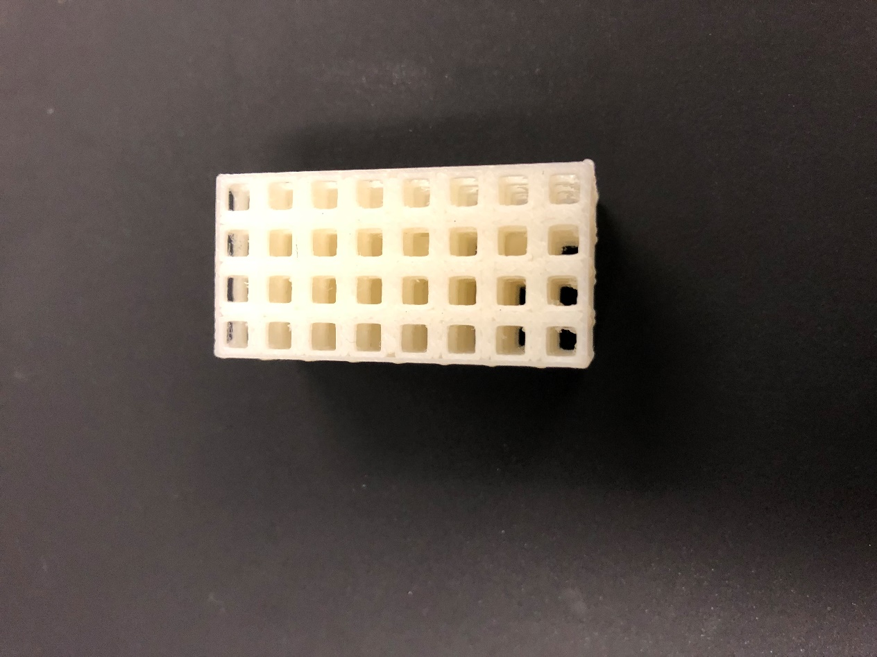
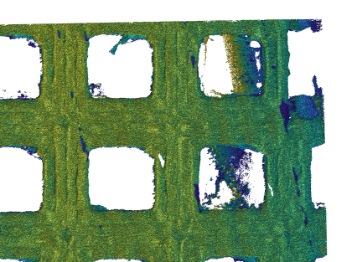
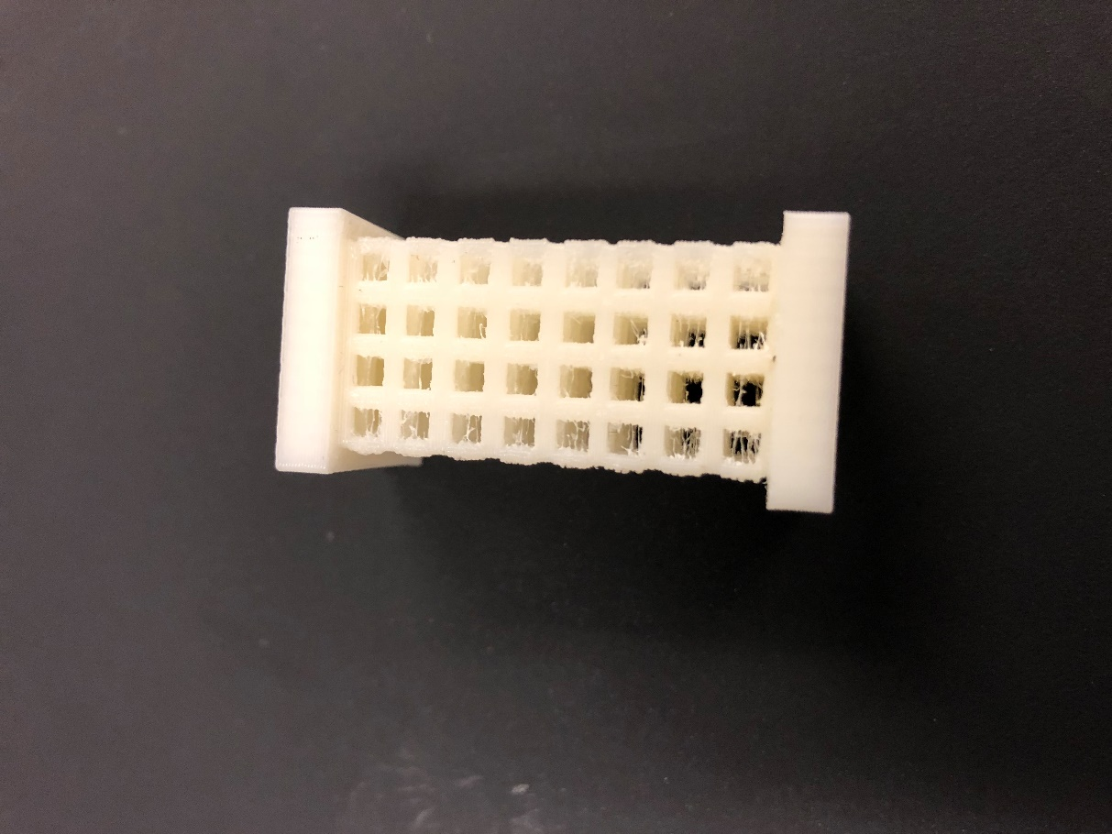
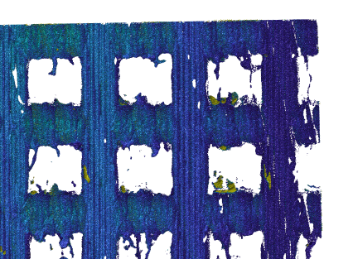
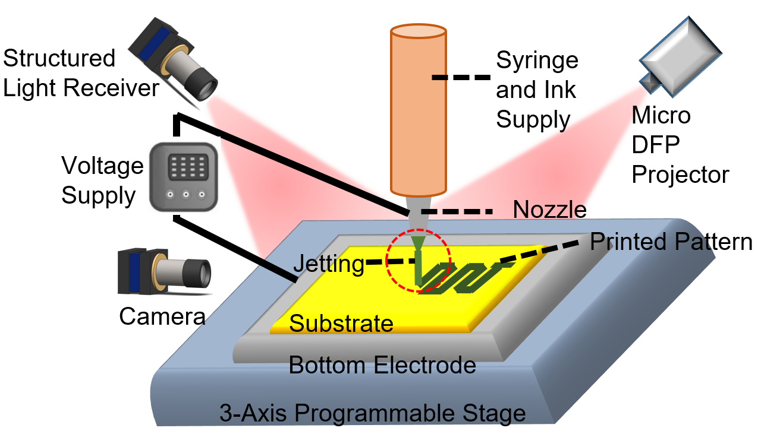
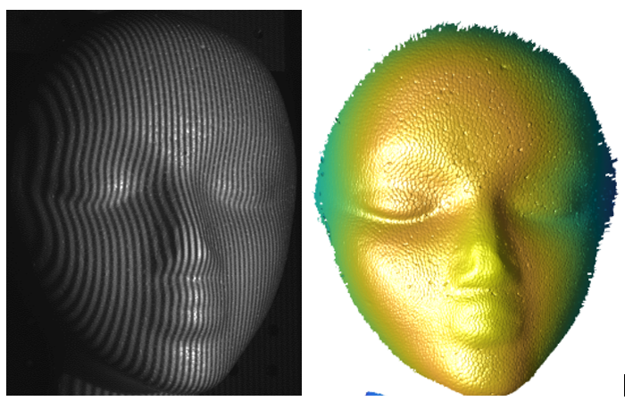
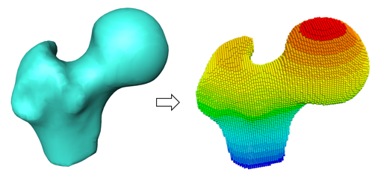
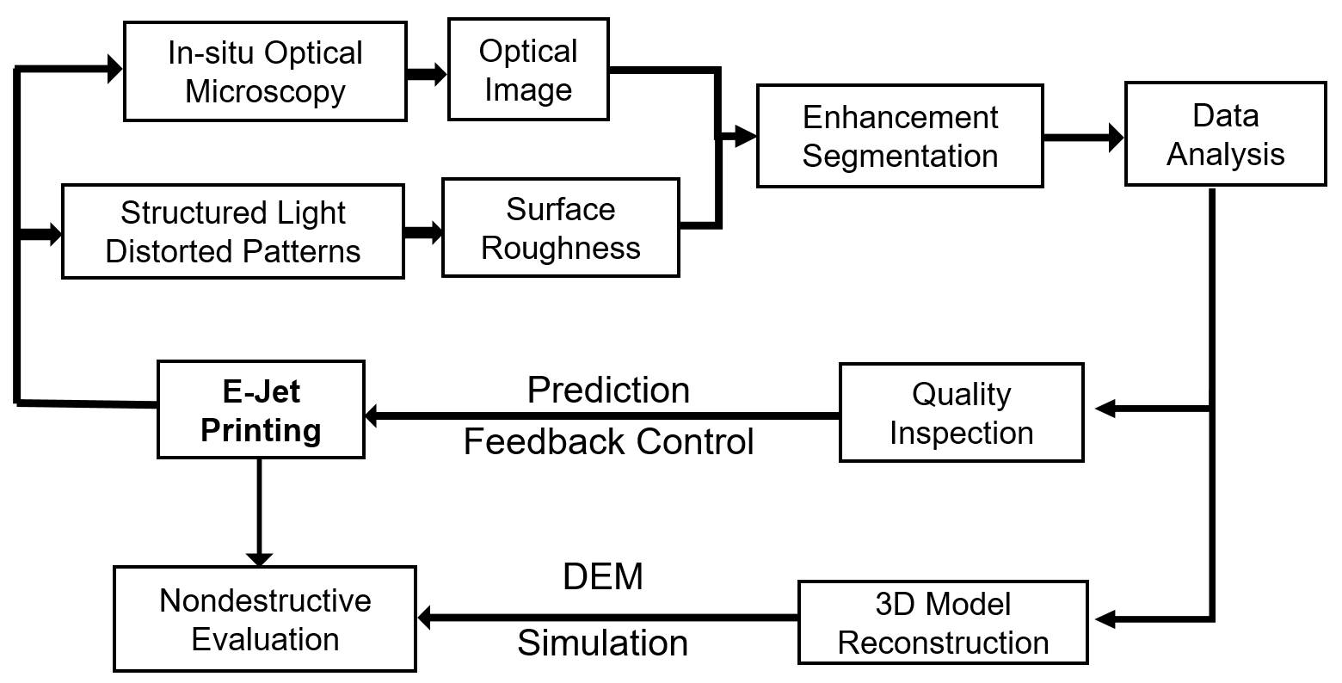
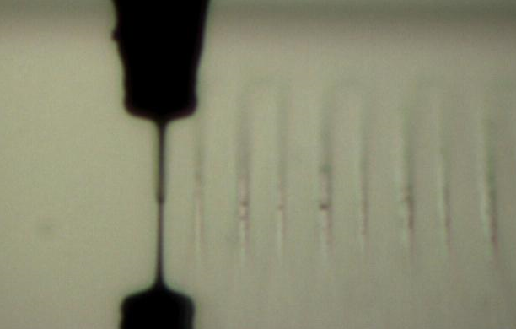
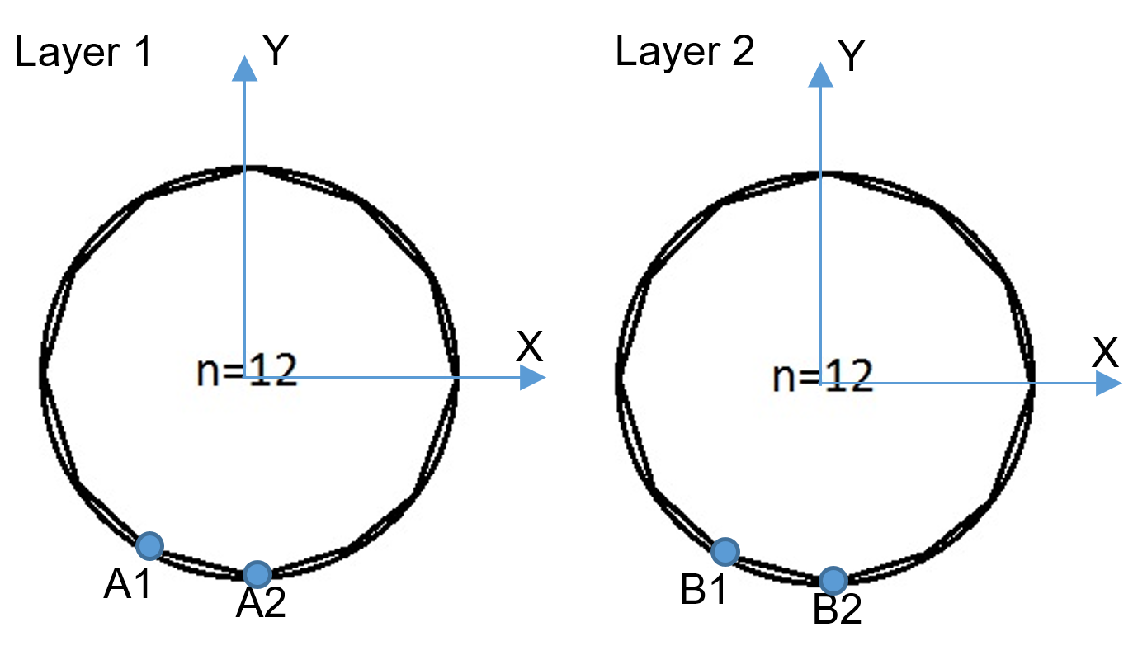
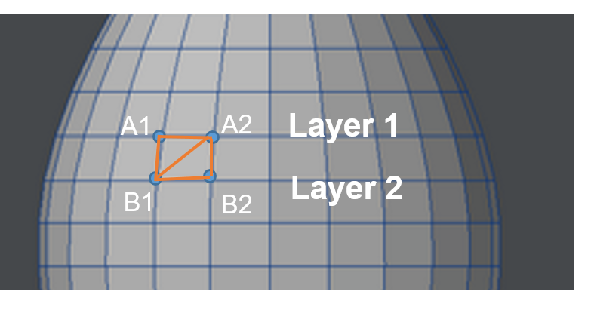
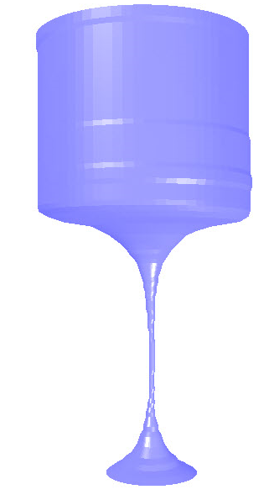
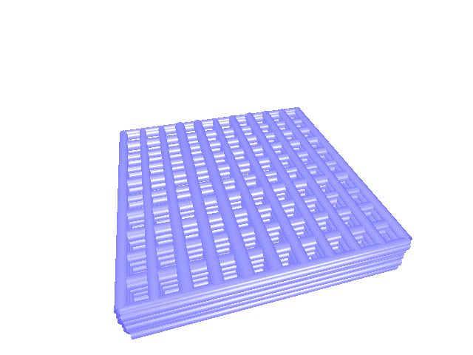
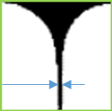
Flexible Electronics & Additive Printing Laboratory (FEAP)
In-situ Characterization of Additive Printing Laboratory (iCAP)
www.imse.iastate.edu/feap
Center for Nondestructive Evaluation
April 2018
Xiao Zhang, Vignesh Suresh, Rahul Singh, Shuo Xu, Aditya Rao, Prashant Polampally, Karthick M., and Hantang Qin* qin@iastate.edu
Model Reconstruction in Additive Printing: A New Approach for In-situ Monitoring and Nondestructive Evaluation of Printed Constructs
INTRODUCTION
Additive printing: heart of industries, e.g. aerospace, automotive, health care
Common Defects: internal voids, porous structures, and anisotropic property
Four challenges: (a) characterization of raw materials, (b) development of design specifications, (c) in-situ process and feedback control, and (d) nondestructive evaluation of final properties
Current assessment method: offline by subjecting the constructs to destructive assays that require staining and sectioning.
(a) (b) (c) (d) (e)
Figure 1: Inaccurate simulations due to: (a) non-uniform surface roughness; (b) non-uniform dimensions at corners due to change of motor speeds; (c) voids between inner layers; (d) redundant material at the edges; (e) porosity of cutting section of a part
Relevance to sponsor needs/interests
Building a prototype for metal-based AM, especially real-time surface roughness and residual stress analysis for metal alloys
Developing high-speed parallel computing for real-time monitoring (knowledge transfer to x-ray in-situ research and ultrasound testing)
Working on a software package (to be a COMSOL/ANSYS module), for quality control of additive manufacturing and property prediction
Identifying a fundamental coefficient “surface roughness matrix” for standardizing predictive process-structure-property relationships in AM
Technical barrier addressed: leveraging cost and reducing defect rates of manufacturing processes, in particular additive printing
Long-term aim for better quality, increased efficiency for additive manufacturing, and reduced labor cost and wastes
Technical objective
Figure 2: Philosophy of ultimate model reconstruction method with feedback control and quality assurance
Abstract:
The objective is to establish a multi-disciplinary framework for:
nondestructive evaluation method for ensuring as-built and as-designed mechanical performance of products
an in-situ process and feedback control system for quality control and quality assurance of additive manufactured products
On the successful completion, we will achieve:
(a) precise prediction of mechanical property of additive printed constructs; (b) direct translations of knowledge into standards for engineering design, in-situ monitoring and feedback control; (c) integration of “smart” additive manufacturing system.
Data fusion of Metal/plastic surface roughness
Structured Light 3D Scanning
(a)
(b) (c)
Figure 5: Structured Light 3D Scanning (a) in-process surface roughness of selective laser sintered steel surface; (b) surface roughness matrix for plastic parts; (c) challenges remains how to integrate the data into reconstructed model in Figure 4 for better simulation and feedback control
Figure 6: Model reconstruction & discrete element methods (DEM) for accurate property prediction of printed constructs: integration of dimensional, geometrical, topographic information for modeling and simulation
Milestones & deliverables
Table 1: Detailed milestones and deliverables for the proposed project
Summary
In-process monitoring is the key towards a “smart” system
We are trying to integrate in-process monitoring data (e.g. dimensional, geometrical, and topographical data) into reconstructing models of manufactured parts
Advanced modeling strategy will be applied to advance understanding of bonding forces in the model
Expected reduced defects rates and accurate simulation results
Technical approach & preliminary results
Task #1: In-situ monitoring and measurement of surface roughness matrix: Oct 2018-Sep2019
Task #2: Model reconstruction and modeling: Oct 2019-Sep2020
Task #3: Feedback control theories: Oct 2020-Sep2021
Figure 3: Schematic drawing of printing system setup
Figure 4: Preliminary results of machine vision system for model reconstruction for Task#1. In-situ monitoring and measurement of surface roughness matrix: Oct 2018-Sep2019
Nozzle & Ink
Zoom Lens
Micro/Nano Features
Substrate
Reflection
Location: (45, 30, 25)
Diameter: 23.42 µm
Location: (45, 0, 20)
Diameter: 18.32 µm
This work to be supported by SPONSOR

